Slide 1
Audio Encryption and Decryption in Image Format for Secured Communication
Authors:
Wriddhirup Dutta
Soumik Mitra
Dr. Kalaivani S.

Slide 2
Introduction
This paper focuses on secured communication platform for audio signals.
These audio signals are encrypted by a randomly generated key in image format.

Slide 3
Methodology
The audio file is read and stored in a two dimensional matrix in MATLAB
  This audio file is then converted to an image.
A random orthogonal key matrix is generated using a function.
  This key is multiplied to the audio matrix, resulting in an encrypted matrix containing the audio.

Slide 4
Methodology…
The encrypted image matrix is then passed through a channel with white Gaussian noise.
  At the receiving end, the Gaussian noise is first removed by a filter.
Then the randomly generated orthogonal key is used to decrypt the encrypted image.
  This is done by multiplying the encrypted matrix with the inverse of the key matrix.

Slide 5
Methodology…
The decrypted audio image matrix is generated.
This decrypted audio is then compared with the input audio.
The signal to noise ratio (SNR) and the bit error rate (BER) is then calculated and plotted for five audio signals.

Slide 6
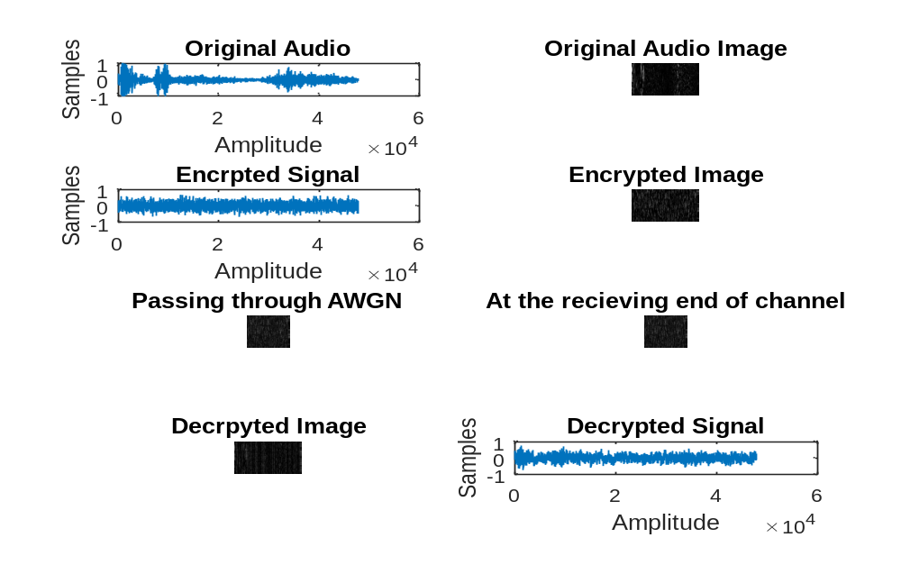
Results

Slide 7
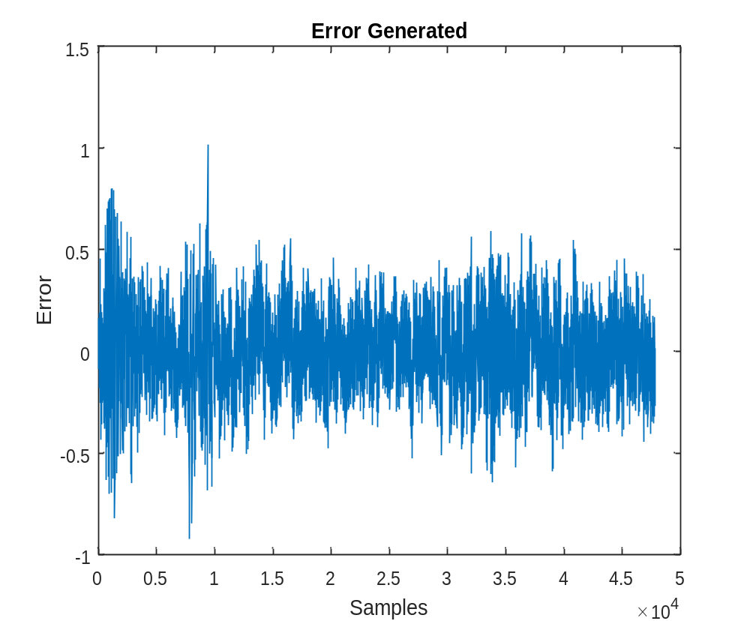
Results…

Slide 8
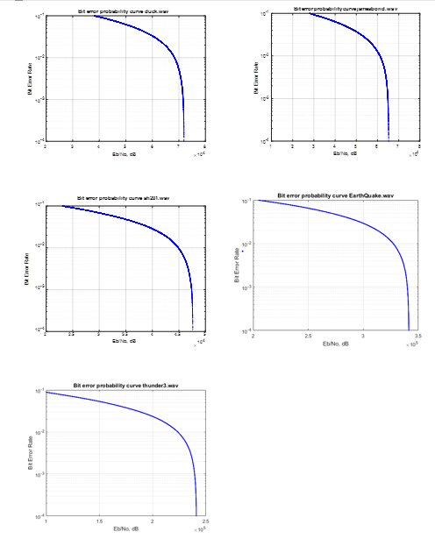
Results…
Fig. BER plot for 5 audio files

Slide 9
Conclusion
The audio signal has successfully been decrypted efficiently.
The error generated between the decrypted audio and the input audio differs for different image compression techniques.
It is seen that error is the least if compression of audio matrix is done through tagged image format (TIF).

Slide 10
References
[1] Kim, C.Y., 1999, May. Reevaluation of JPEG image compression to digitalized gastrointestinal endoscopic color images: a pilot study. In Proc. SPIE Med. Imaging (Vol. 3658, pp. 420-426).
[2] Matlab, U. (2017). Using audioread on a MP3 File in Matlab. [online] Stackoverflow.com.https://stackoverflow.com/questions/29806998/using-audioread-on-a-mp3-file-in-matlab.
[3]Lee, Che-Wei, and Wen-Hsiang Tsai. "A lossless data hiding method by histogram shifting based on an adaptive block division scheme." Pattern Recognition and Machine Vision, River Publishers, Aalborg, Denmark (2010): 1-14.
[4] In.mathworks.com. (2017). RandOrthMat - File Exchange - MATLAB Central.https://in.mathworks.com/matlabcentral/fileexchange/11783-randorthmat

